Slide 1
PCM Inernals
By Leo.C.Wu
April.8th 2013

Slide 2



Kusu
  backend for pcm/hpc before PCM4.1
Fujitsu_CE
  custom project for Fujitsu
XCAT
  open source project
PCM4.1
  commercial software
Others
  Bright computing cluster manager
  RedHat spacewalk
  Cobbler
  FAI

Slide 3

Kusu/Fujitsu_CE
  TUI and CLI based, easy to build clusters, but less hardware management related feature
XCAT/PCM4.1
  For expert, CLI based, full feature

Slide 4

Network hardware topologic
  kusu/PCM4.1
  Fujitsu_CE
  XCAT
Software architecture
  kusu/Fujitsu_CE
  xCAT/PCM4.1

Slide 5

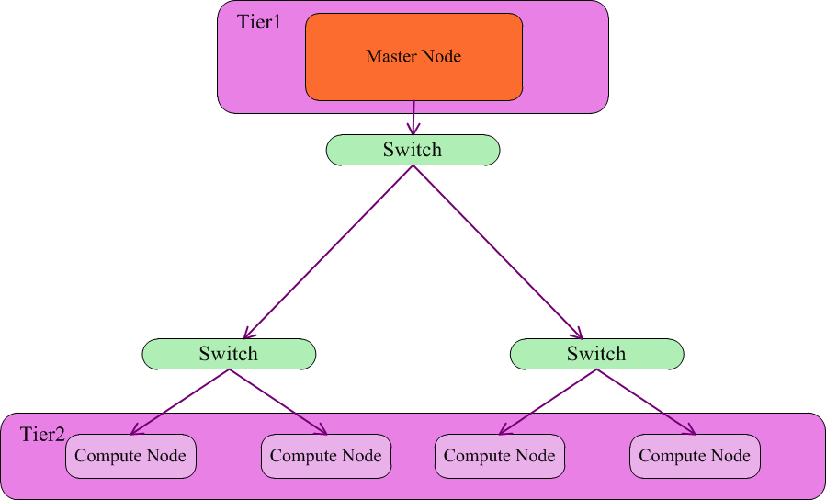

Slide 6

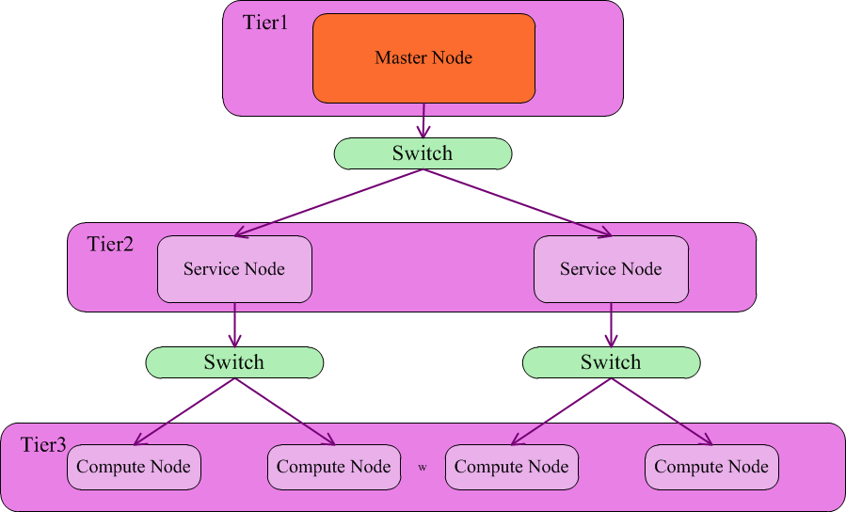

Slide 7

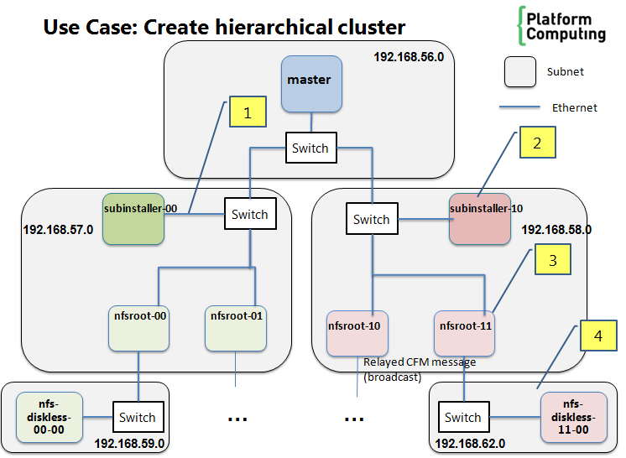

Slide 8

Kusu
  Up to 1K nodes
PCM 4.1
  Up to 1K nodes
Fujitsu_CE
  Up to 100K nodes
XCAT
  Up to 100K nodes

Slide 9

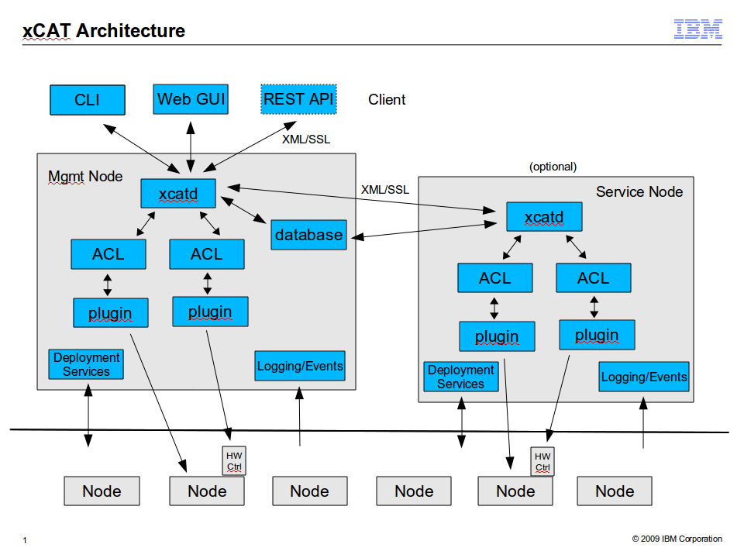

Slide 10




Installer Node
Kusu Config Generator
Kusu CFM
Kusu RC
KUSU
Kusu
CLI
Kusu Config
Management
Kusu Status
Notification
Kusu HA
Kusu Template Files
Kusu CFM Files
Kusu RC Scripts
User Post-Install Scripts
Kusu DB
Kusu Config Mgt Files
Kusu SoftwareMgt Files
Enables DHCPD, / Virtual IP
Kusu
Repo
Files
Kusu Kit Files
Kusu Image Files
LINUX OS
Provisioning Services
(dhcpd, tftpd, httpd)
System Services
(named, ntpd, nfsd, sshd)
Local OS Config Files
(/etc/hosts, /etc/fstab, etc.)
Local RPM Packages

Slide 11

Node:
  A host provisioned by installer node
Node Group:
  A couple of nodes that shares same properties, like network, software, hardware configurations, and major in same tasks, eg: file sharing, computing tasks.

Slide 12

Repository:
  A set of rpms/deb packages
    For RHEL/SLES: A yum repository
    For Debian/Ubuntu: A software source
  Support install program(anaconda/autoyast/debinstaller) to deploy basic software onto compute node
  Support for image building

Slide 13

Kit
  A set of rpm/deb packages
  Kit is an independent software could be put into a repo
  Kit could be assign to different repository
Component
  A set of rpm/deb packages
  Component of a kit, is a module of a software

Slide 14

Discrete rpm < Component < Kit < Repository

Slide 15

Network
  A kind of configuration for node/nodegroup to follow up.
  Specifies ip address, net mask, gateway
Nic
  Network interface card installed on node
  All nic on a node should has its unique device name like eth0, eth1, bond0, etc…_x0013_

Slide 16

Node Type:
  Stateful
  Stateless
  Statelite
OS Distribution:
  Rhel
  Sles
OS update

Slide 17
Partition schema
Kernel parameters
Packages
  OS Packages
  Custom Packages
Kit Components
Post scripts
  Post install scripts
  Post boot scripts

Slide 18

Network
  IP/Netmask/Gateway
NIC
  Type: Ether net, BMC, Infinite band
Relationship
  NIC and netork

Slide 19

System Type:
  P serials, X serials
Hardware related information
  Command mappings
BMC info
  Password, username, port etc…
Serial info
  Flow, port, speed

Slide 20

Provision Template
  Image template
  Network template
  Hardware template(optional)

Slide 21

Scripts:
  Boot up scripts
    First boot
    Normal boot
  Sync up scripts
    Before sync
    After sync
  Install scripts

Slide 22


